Slide 1
5 SLIDES
By: Marius Asadauskas & Julius Oeftiger
Fabrication and Prototyping in the Learning Lab
1.12.2022

Slide 2
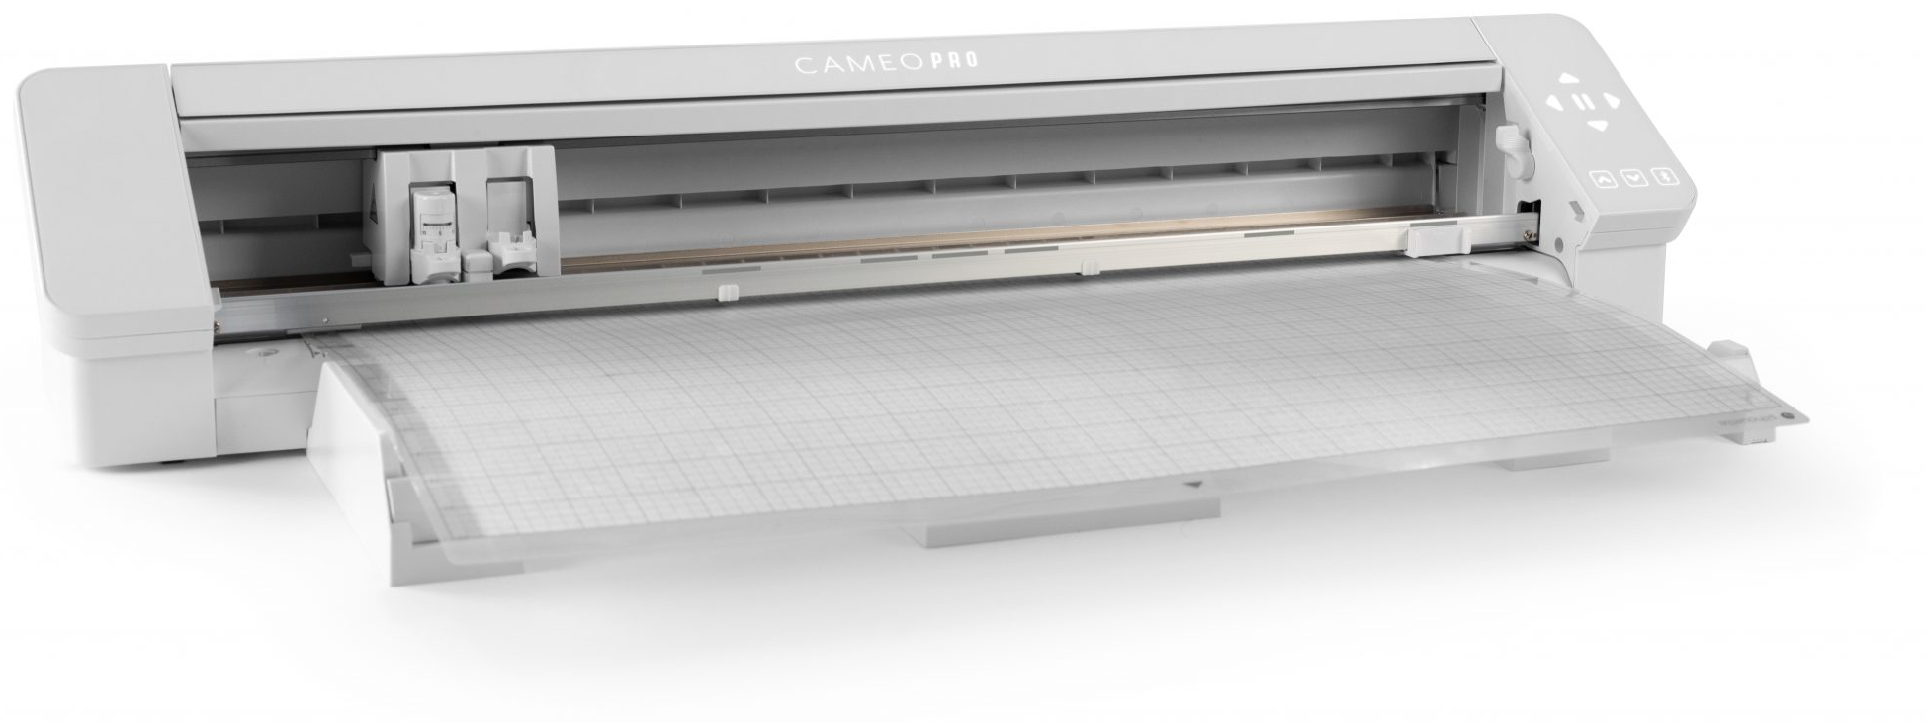
SILHOUETTE CAMEO 4 PRO
Vinyl cutter
Needs specific commands
Needs vectors
Notes:
Image source: https://skatkatz.com.au/product/silhouette-cameo-4-pro/

Slide 3
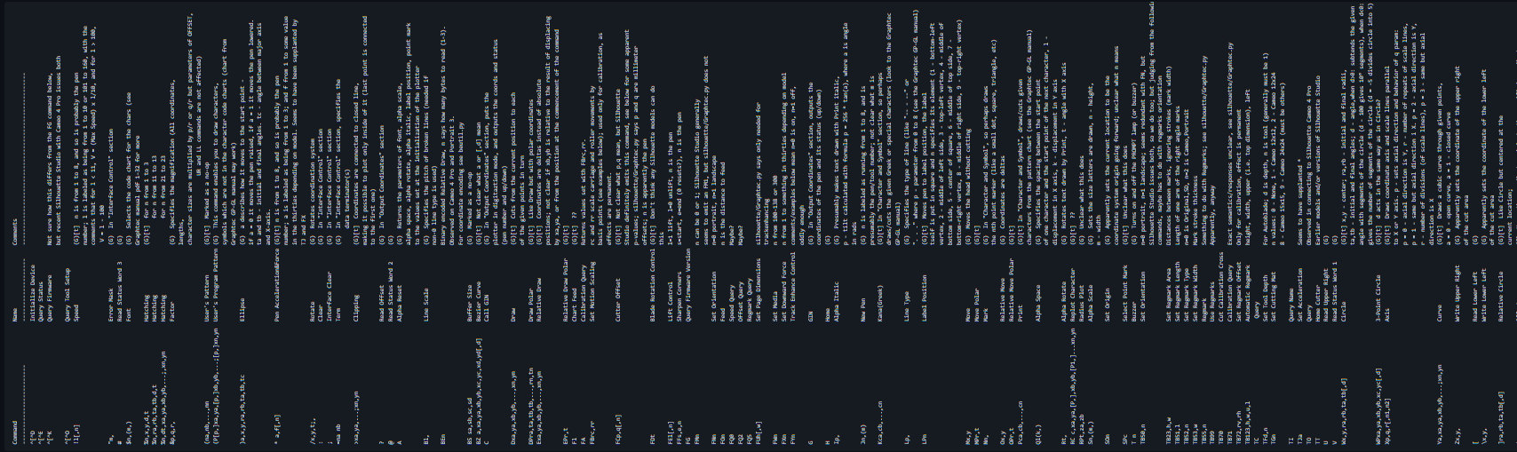
Silhouette Commands

Slide 4
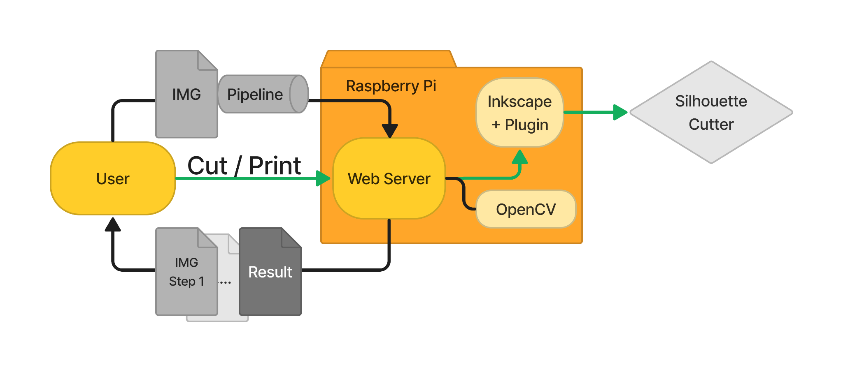
Process (WIP)

Slide 5
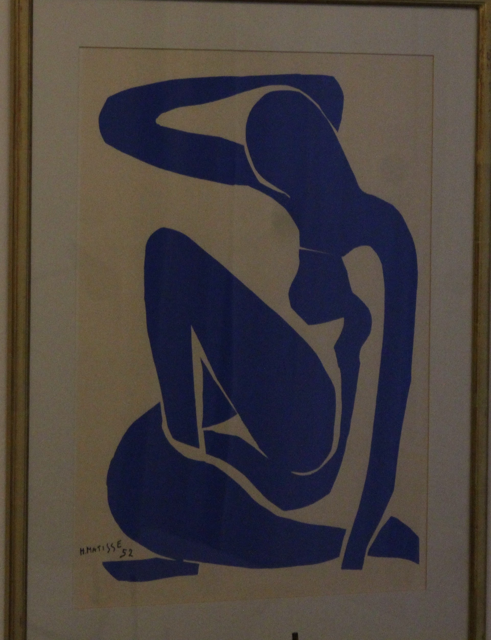
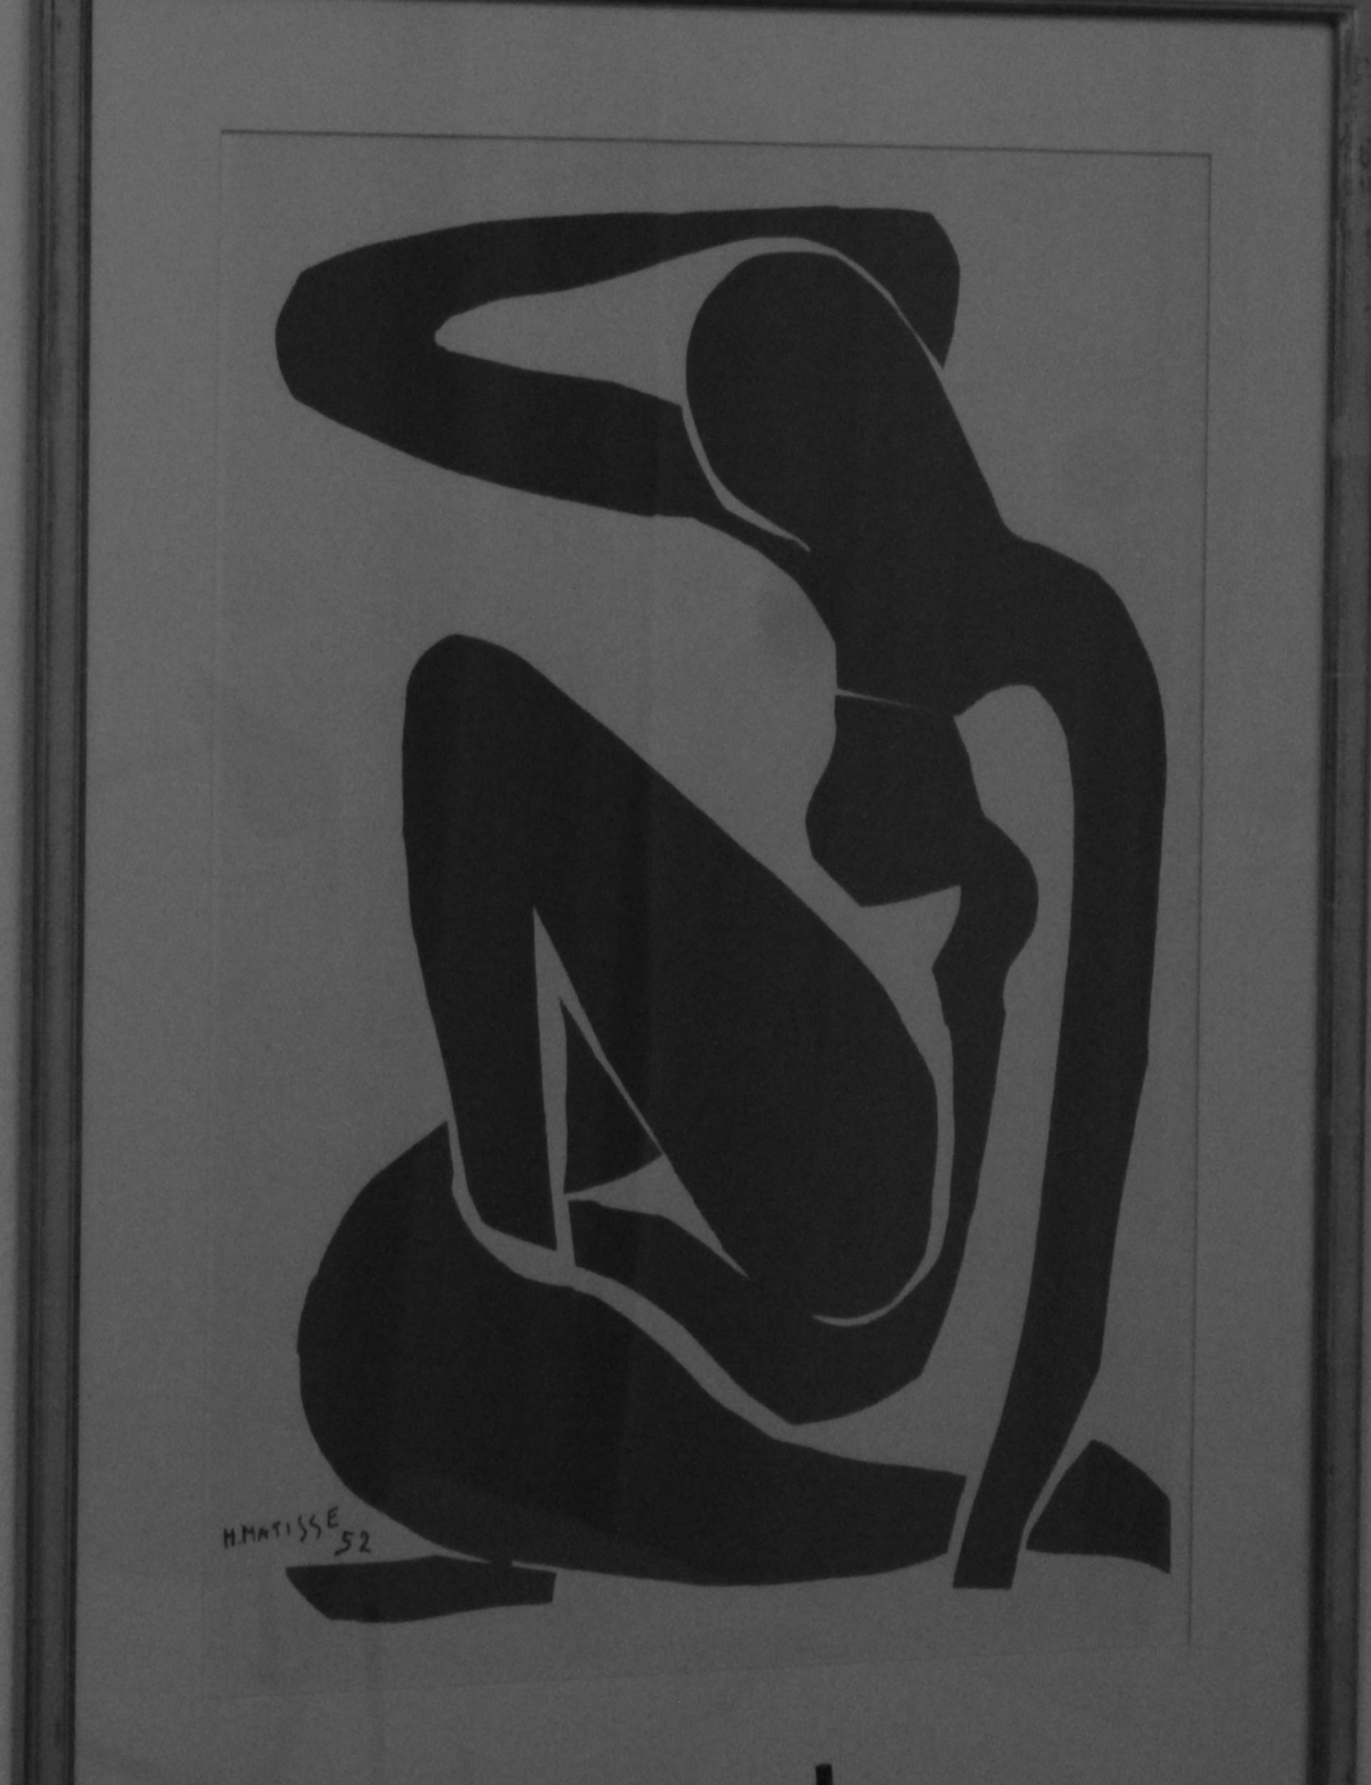
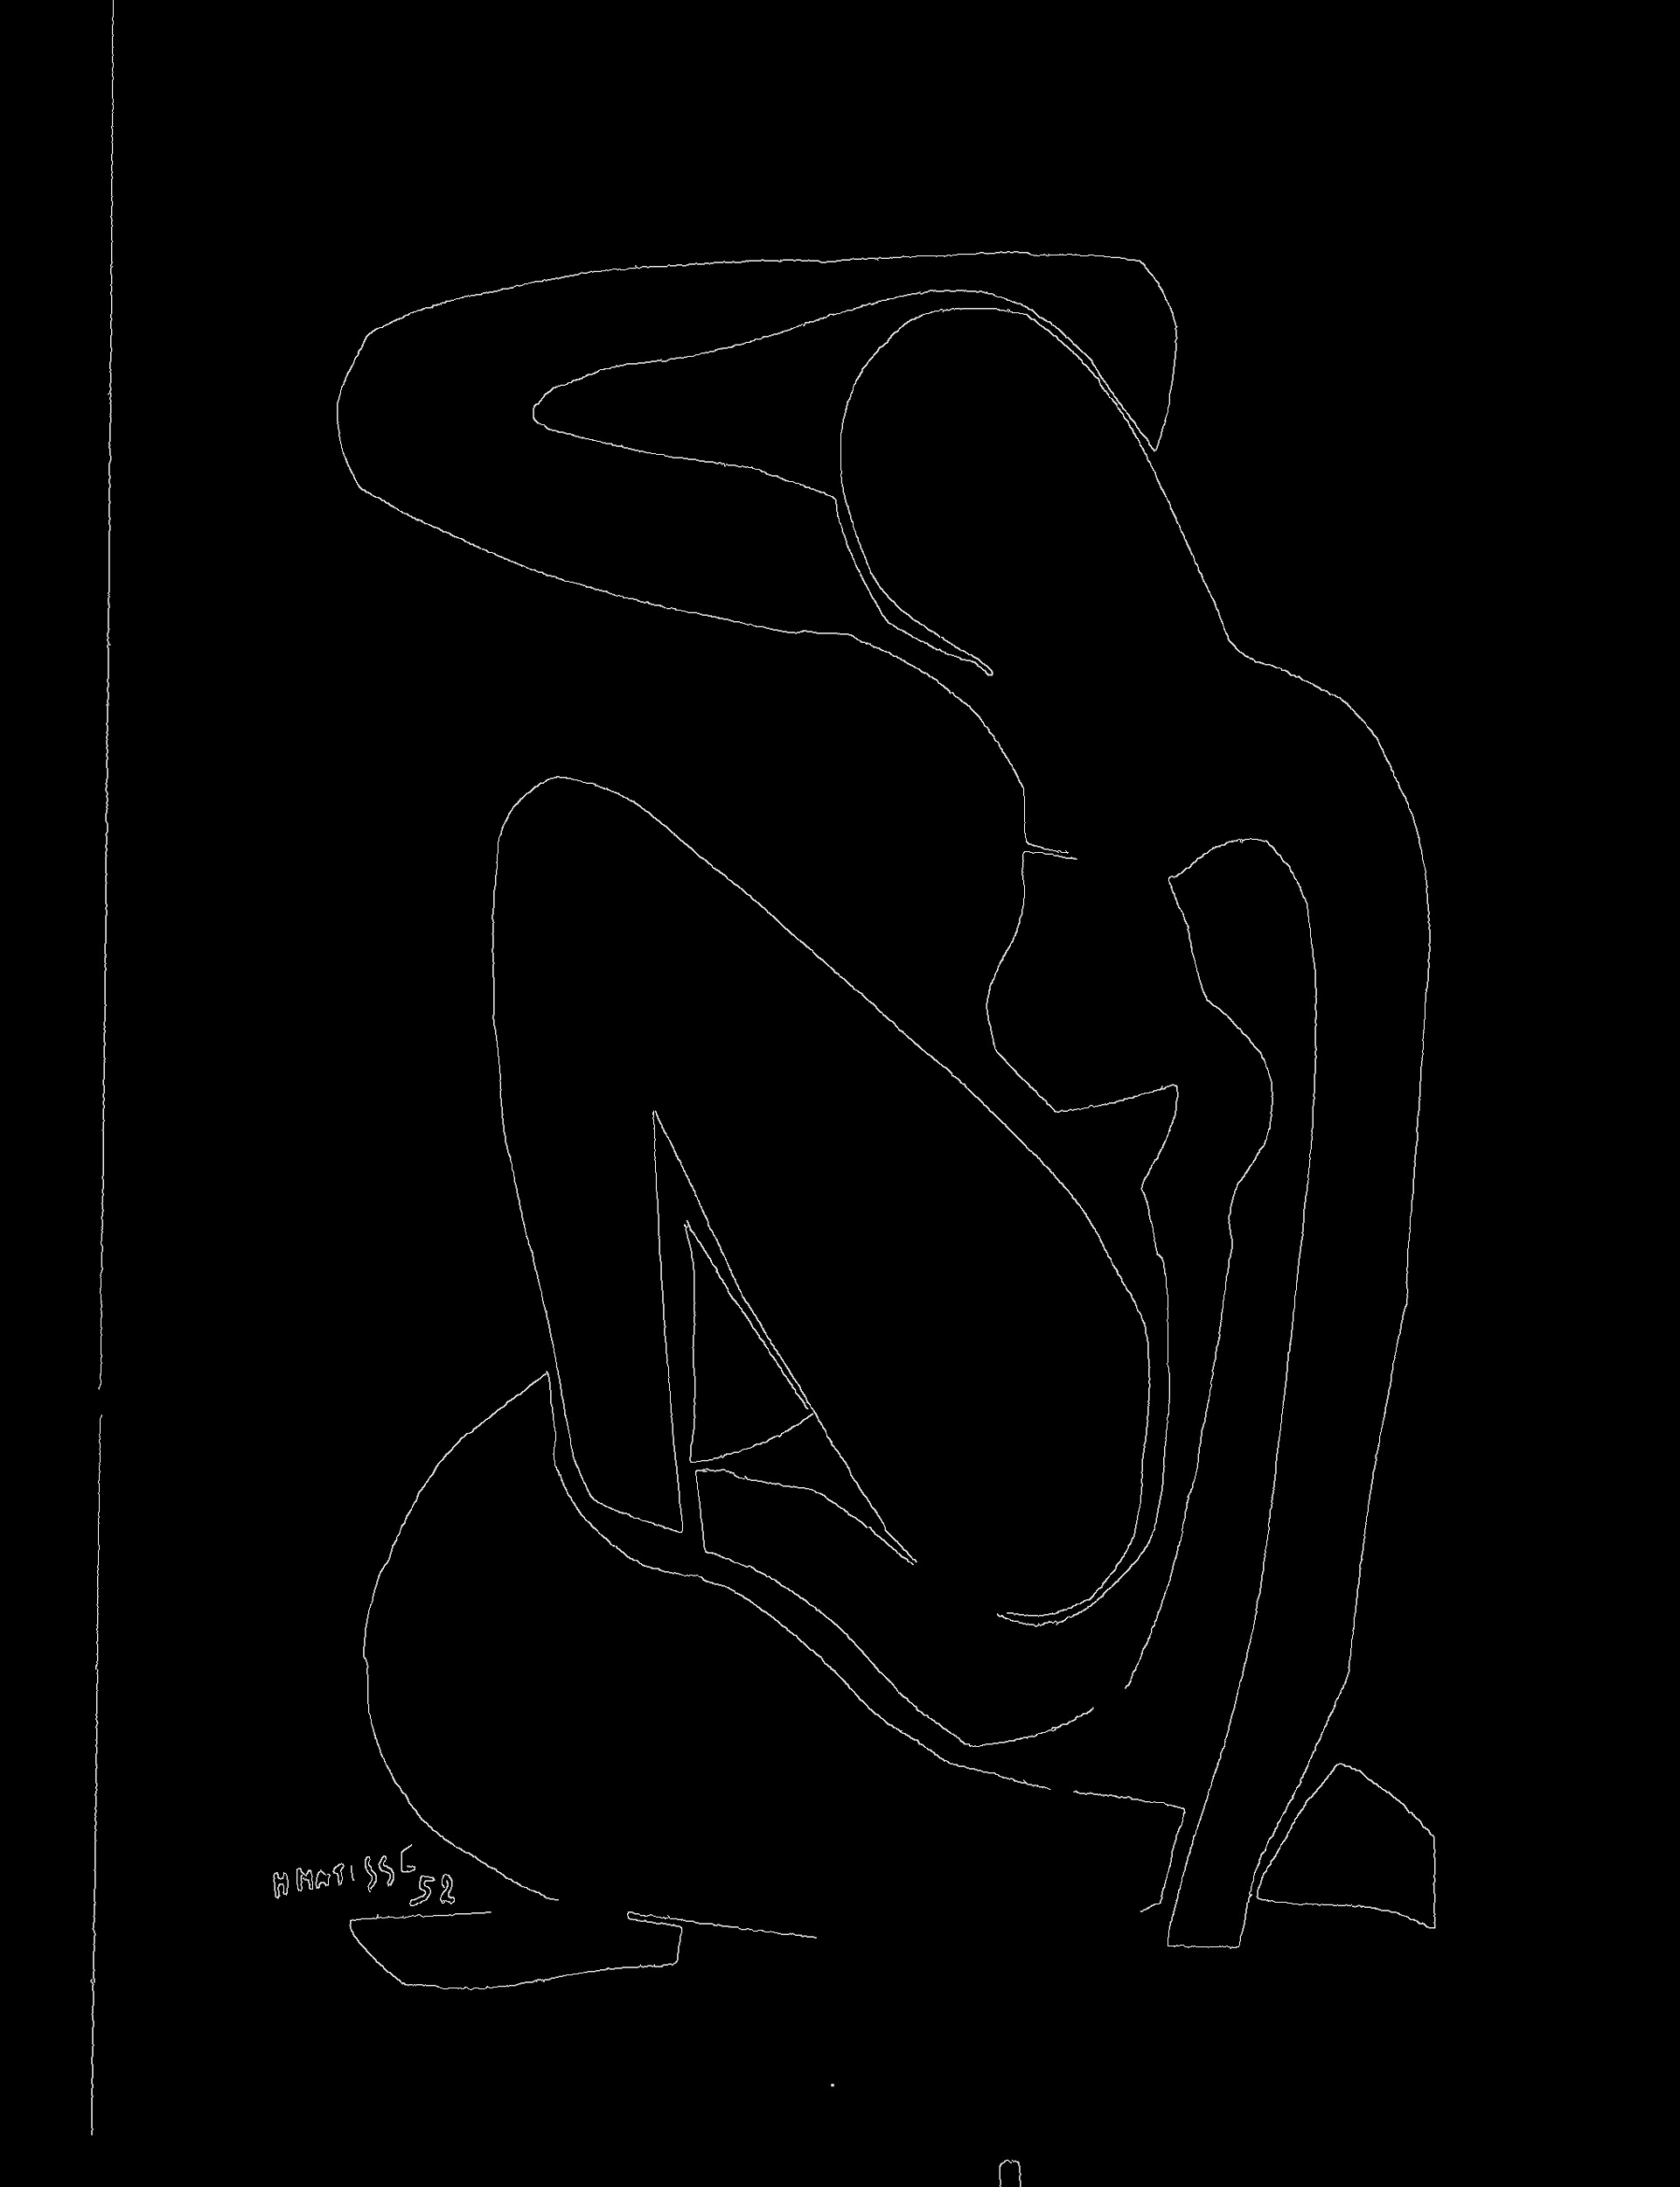
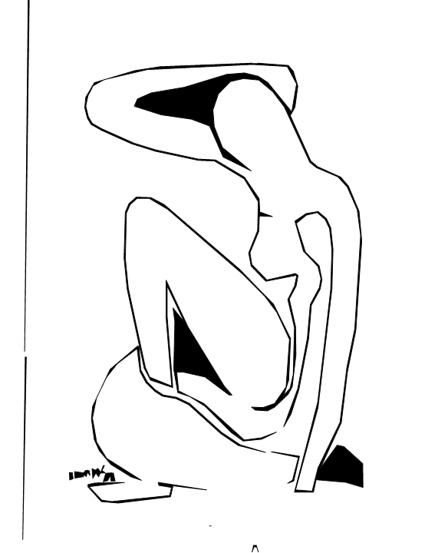
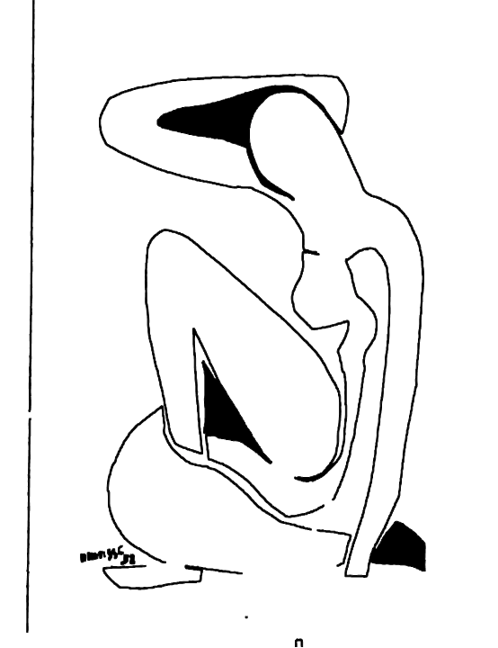
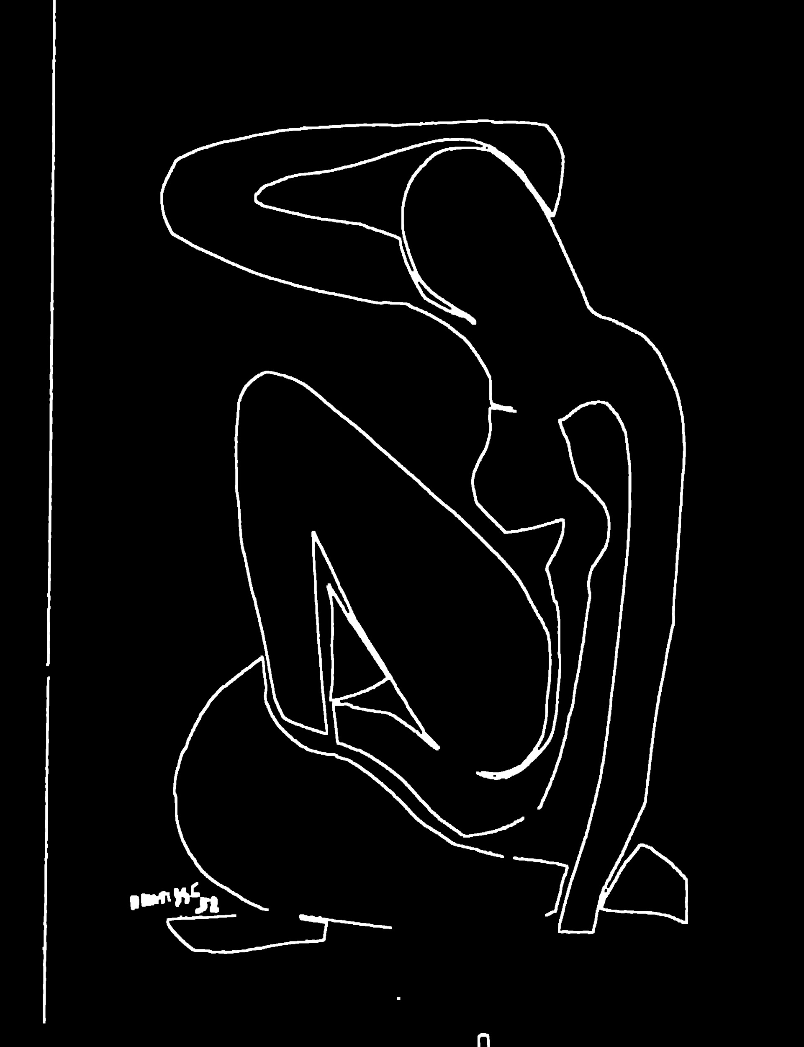
Pre-Process
Edge-Detect
Amplify
Smooth
To SVG
N=317
N=7098

Slide 6
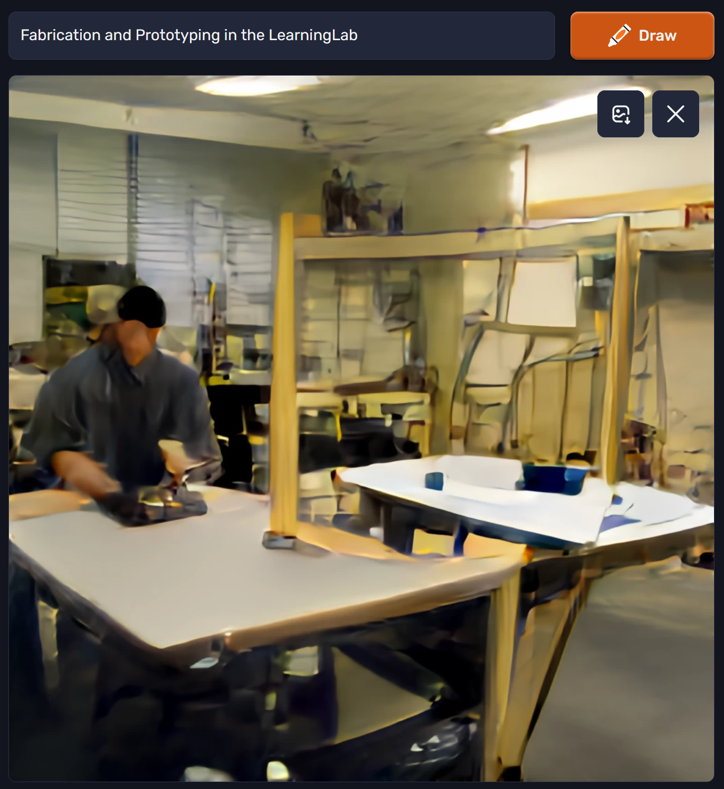
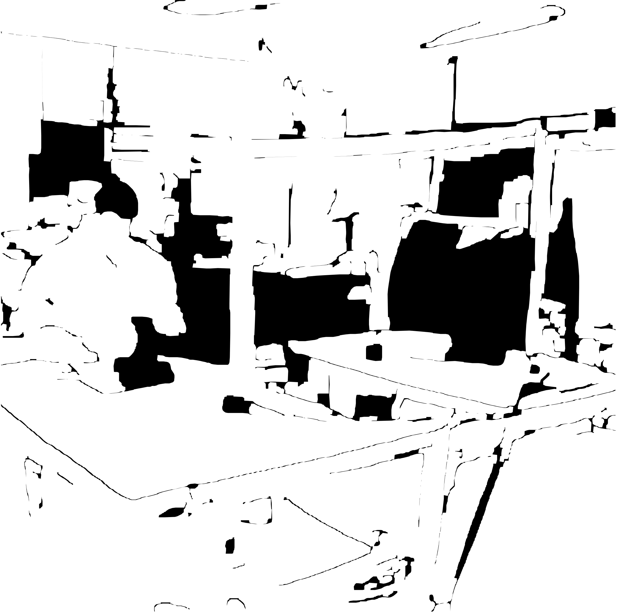
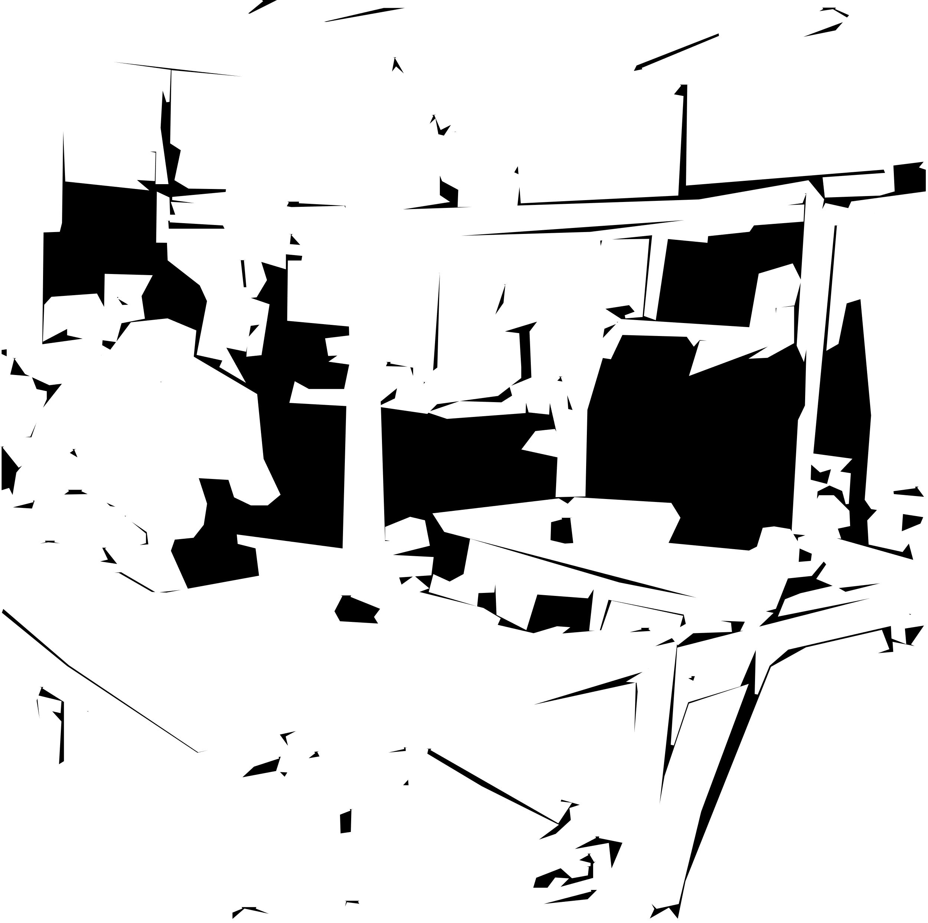
AI Art
Notes:
Image from: https://www.craiyon.com/

Slide 7
THANK YOU FOR LISTENING

